Slide 1

Nordstrom’s 114-year-old
Culture in the Tech Era
Sarah Lake Hagan
Notes:
I’m going to talk about Nordstrom’s technology division, which is doing some pretty awesome things! From our mobile point of sales systems, infrastructure support, Rack and Full Line websites, and our customer mobile apps, we’ve got a lot of things going on—in fact, Nordstrom Technology has grown almost double in the past three years. Our influx of hiring new-to-Nordstrom employees mixed with being in the middle of the Tech era meant we needed to be more explicit than ever about our culture. Considering Nordstrom is over a century old, how did we introduce this new change while maintaining our history? I’m going to start off this talk by explaining a little bit about how we created our new cultural framework, how we’ve introduced this concept to our teams, and how we continually try to embrace the culture so that our employees can create some amazing customer experiences—wherever our new tech talent may come from, regardless of skillset, it’s essential that they rally around customer service! I’m also going to litter in some take-home tips that you can bring back to your company regarding cultural change, especially at an established workplace such as a 114-year old company.

Slide 2
OUR ONE RULE
Use good judgment
in all situations.
Notes:
Since 1901, this has been the Nordstrom employee handbook. Just one rule: use good judgment in all situations. You may have heard the story about a customer who returned a tire to a Nordstrom location in Alaska, converted from a former automotive store, and received a refund even though we’ve never sold automotive products. Or you may have a personal story about how you’ve received amazing customer service on the sales floor—these types of stories stem from that one rule.
It seems fitting, then, that our Nordstrom culture has been built around this rule. In the last few years, however, Nordstrom has grown quickly such that we’re competing for top talent in both the retail and technology realms. While many people continue to be developed from within, the pace of the market has demanded that we look to external talent pools—we’ve broadened our recruiting and development funnel such that we’re bringing in more external employees in a rate that’s been unprecedented for us.

Slide 3
We are in the midst of 3 strategic inflection points that impact our work:
Our industry
TECH
Rise of mobile
Cloud technology
Open source
Machine learning
Automation
RETAIL
Shifting channels
Changing consumer expectations
Technology driving new experiences
WORKFORCE
Multiple generations
Culture of entrepreneurship/startups
Purpose economy
Employees’ market
Notes:
We’re in the midst of three inflection points in our industry that impact the type of work we do and the scope of how we work.
In Technology, there’s the rise of mobile ordering, the use of cloud technology, open-source code, machine learning, and automating as much as possible.
In Retail, we’re seeing the rise of shifting channels from in-store and commerce to omnichannel strategies, and full price and off-price becoming more connected. We’re seeing consumers shift their expectations of how they want to be served, and technology has become a key enabler of new customer experiences
In the Workforce, there is an insurgence of millennials to the workforce, (and arguably 5 unique generations in the workforce at once), the barrier to entry for employees to leave and launch their own startup is low, and employees are now seeking companies that offer them purpose and meaningful work . Mixed with the low unemployment rate, these shifts indicate a need for new strategies for engaging and retaining employees.
Sound familiar to you? I’m guessing at least two of these three are the same to you! Add it on top that…

Slide 4
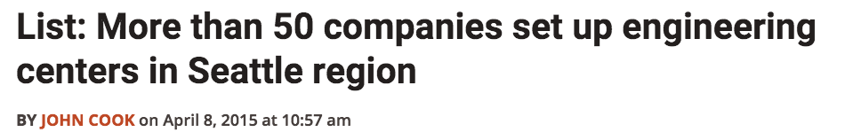

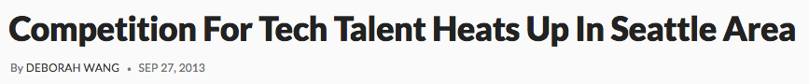
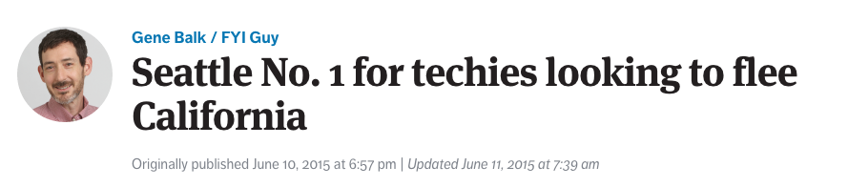
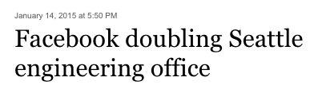
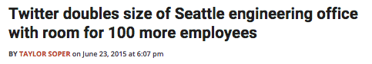
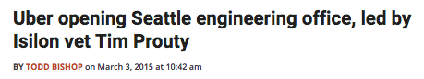
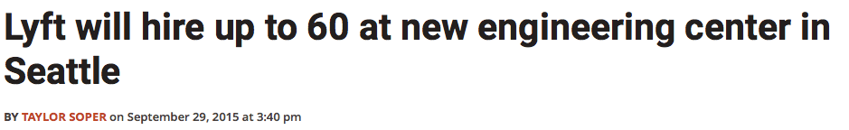
The competition for technology talent is more fierce than ever
Notes:
…the competition in Seattle for tech talent is getting more and more competitive.
Given this competition ever combined with our hiring new-to-Nordstrom employees, we needed a way to both introduce them to the Nordstrom culture and be receptive to including their ways into ours—and do it quickly so employees can immediately start feeling as if they’re part of the culture.

Slide 5
Research shows company culture impacts performance
Gallup found that companies with engaged employees had 22% higher profitability and 10% higher customer ratings
-New York Times, Why We Hate Work, May 2014
$
2x
Fortune 100 Best Companies to Work For
perform nearly 2x better than the general market
-Great Places To Work, 2015
Notes:
Why should you care about culture in the first place?
Traditionally when we want to improve the bottom line, the places we would look would be improving efficiency, increasing output, and leaning out the processes to get more value. Research now shows that company culture has a big impact on the bottom line – a 2014 Gallup study showed that companies with engaged employees had 22% higher profitability and 10% higher customer satisfaction. For companies that can get culture right, it’s a significant competitive advantage: Great Places to Work found that the Fortune 100 Best Companies to Work For perform nearly two times better than the general market.
Given this research, companies are now being thoughtful and intentional about developing culture not just to make their employees happy, but also to increase productivity!
At Nordstrom we’ve always prided ourselves on our culture. We’ve been on the Great Places to Work list for 18 years, so we believe our culture differentiates us and is the key to delivering amazing customer experiences. We’ve engaged our employees by entrusting them with our one rule and acting as if it’s their name on the door. We believe that the long-term path to success requires a focus on both productivity and employee engagement—we believe investing in the employee experience is good for business.
So how did Nordstrom stay on this list for 18 years even while moving into the tech era?
15 Nordstrom Technology leaders and individual contributors set out in Fall 2012 to figure out this conundrum. Using a design thinking-based approach, they conducted tours, interviews, and visits with 40 companies like PayPal, Nike, Intuit, Toms Shoes, SpaceX, and even a team of Navy Seals to understand leadership in technology and retail. After those visits, we realized it’s not just about leadership, it was the culture and work climate of these companies that the team saw as drivers of their results.

Slide 6
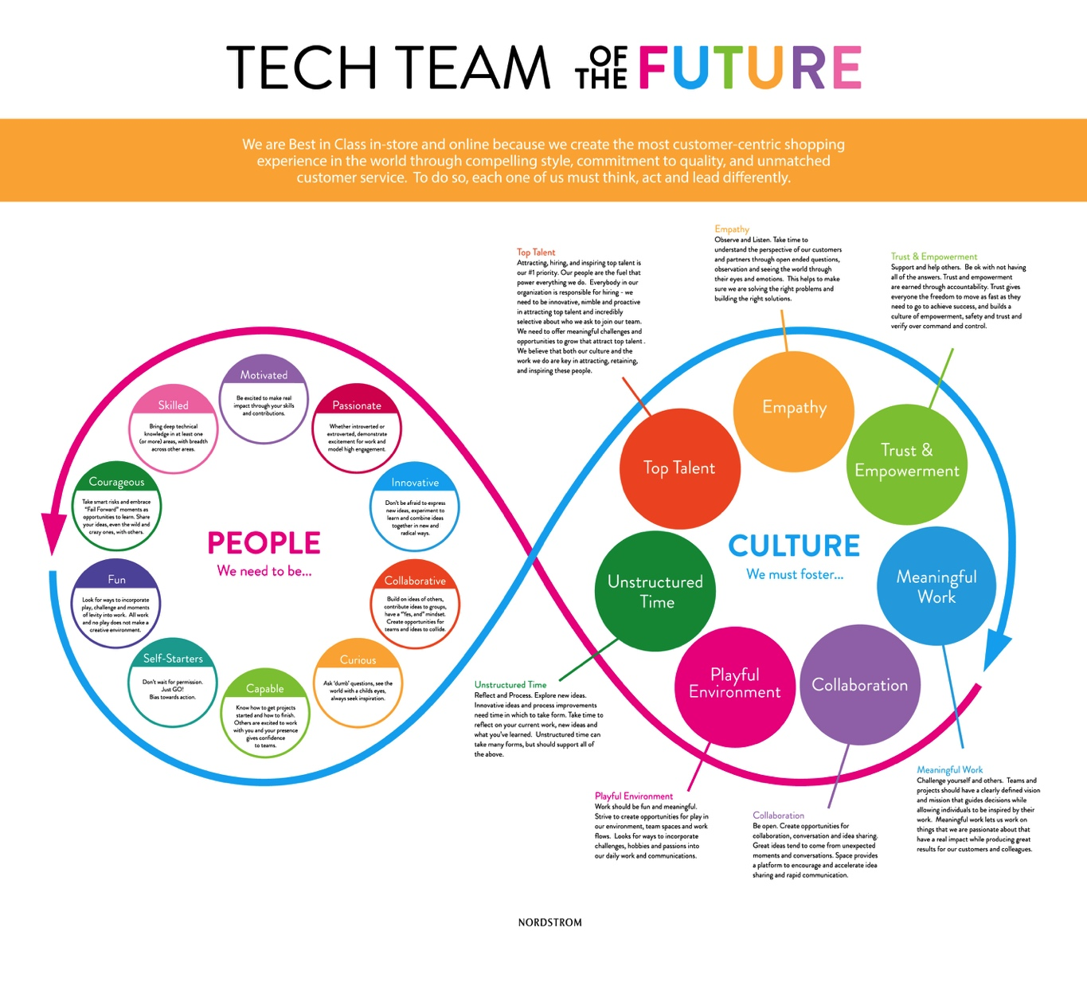
Notes:
We realized simply saying “use good judgment” as a stand-in for implicitly understanding the Nordstrom values and culture is hard to conceptualize as someone new to the company—many new people don’t start on the sales floor, so we wanted to be more explicit and intentional about our culture to ensure they are incorporated into our daily work practice. Not surprisingly, we wanted to articulate, measure, and coach our culture and values in a deeper way than we ever had before.
All their work culminated with this, what they called the Tech Team of the Future. The framework was designed to capture values that are core to our heritage, such as using good judgment and delivering amazing customer experiences, while also challenging us to evolve new cultural capabilities that will enable us to create an inspiring work environment that develops and attracts talented people to our team.
Does that look a little overwhelming and on the wordy side? We thought so too, so we iterated:

Slide 7
Notes:
And came up with something a lot more simple. This happened a few times: after receiving feedback from business partners internally and externally, the framework changed.

Slide 8
Get everyone involved.
Take-home 1:
Notes:
This brings us to our first take-home: get everyone involved. NorDNA didn’t come around by just those 15 people, or even just the people they consulted after coming back from their trip. In fact, they went through three months of showing their draft to others, making sure that they were hitting on the key elements. They consulted over 900 Technology employees by taking them on a tour of NorDNA and how we got there. Funny story: apparently the original version had an arrow between the People and Culture sides that said “Hire” to connect both sides, and employees thought it meant we were going to fire everybody then hire new people that embodied the culture. We crossed out that arrow so fast that I couldn’t even find it to show you!
Asking all these employees, we wanted to ensure that everyone felt comfortable with creating a new shared language of culture, and that everyone felt like they had a part in contributing. I can’t stress this enough: it took a long time to get buy-in from everybody, but they knew the more people who have their hands on your cultural change, the easier it is to get people to buy into this “new” culture.
You’ve seen more than a few culture decks floating around on the internet, and most of them are pretty awesome. The deck, however, isn’t the important part—the journey, reminders, and focus on culture are.

Slide 9
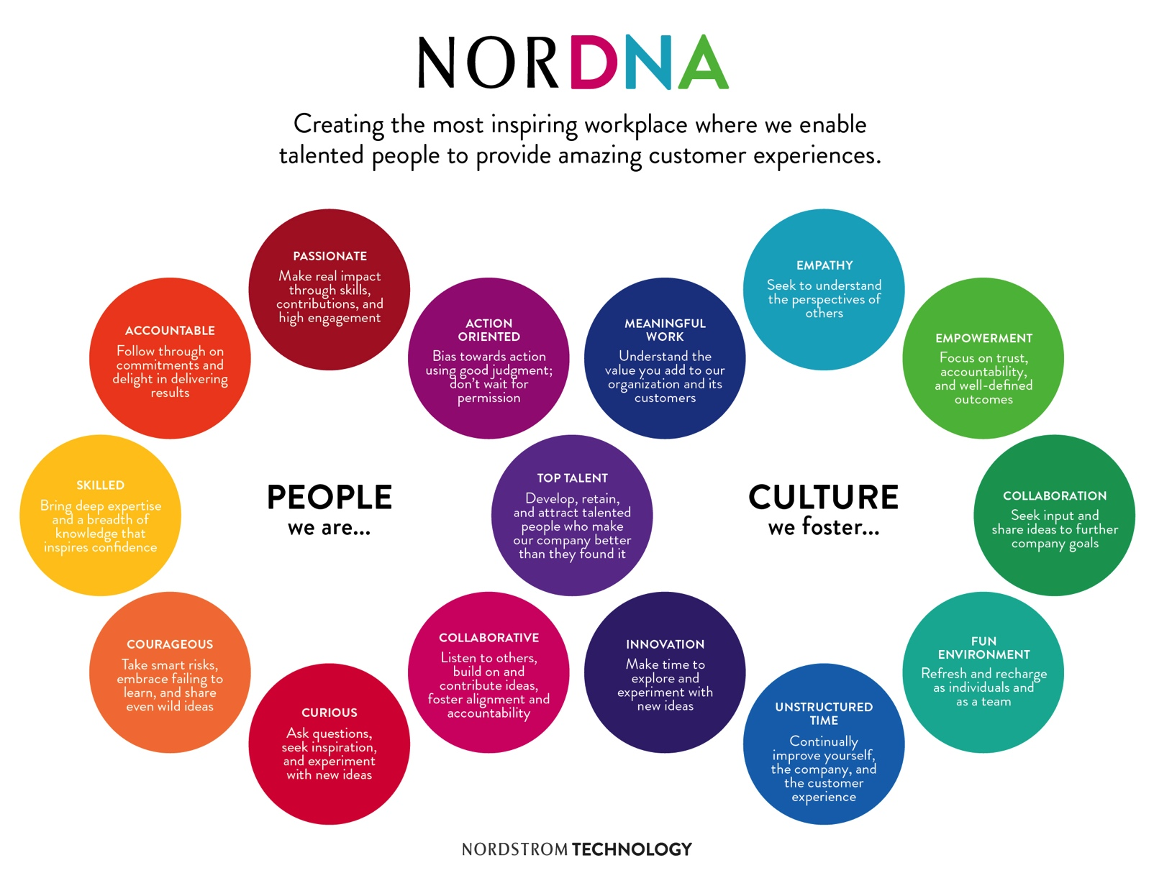
Notes:
This is our current NorDNA framework, and it wouldn’t surprise me if it evolved, since it should! But this is where we’ve landed for the last two years. You can also see it’s a happy balance between being overly wordy and not explicit enough.
To explain the diagram…

Slide 10
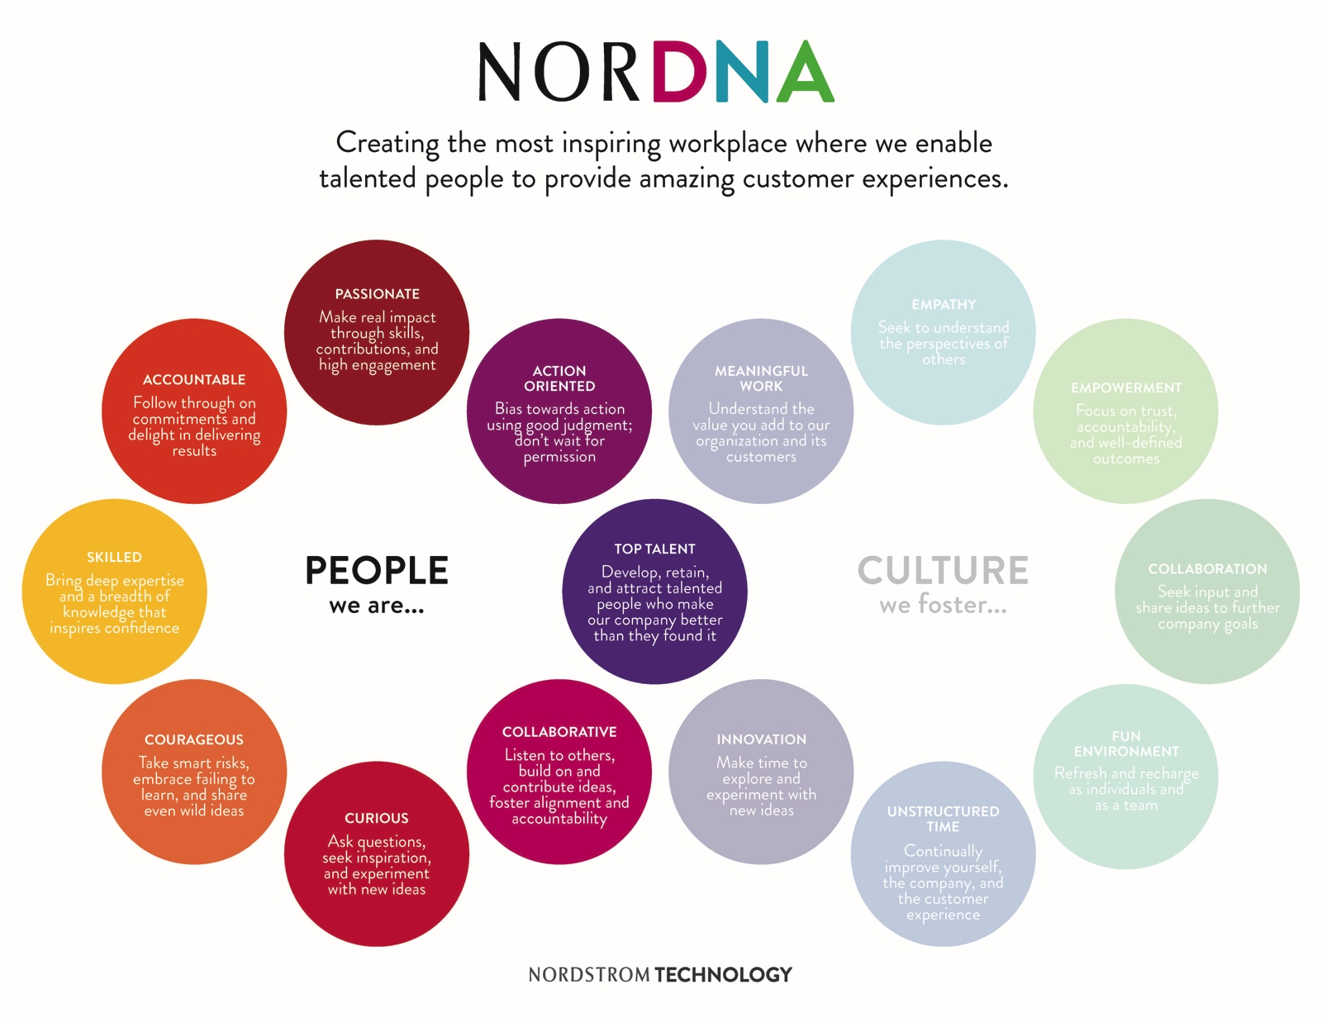
Notes:
The left side of the framework focuses on traits inherent to our people. We believe that at the end of the day, it is our people that power our services, deliver great experiences to our customers, and create a long-term value for our company.

Slide 11
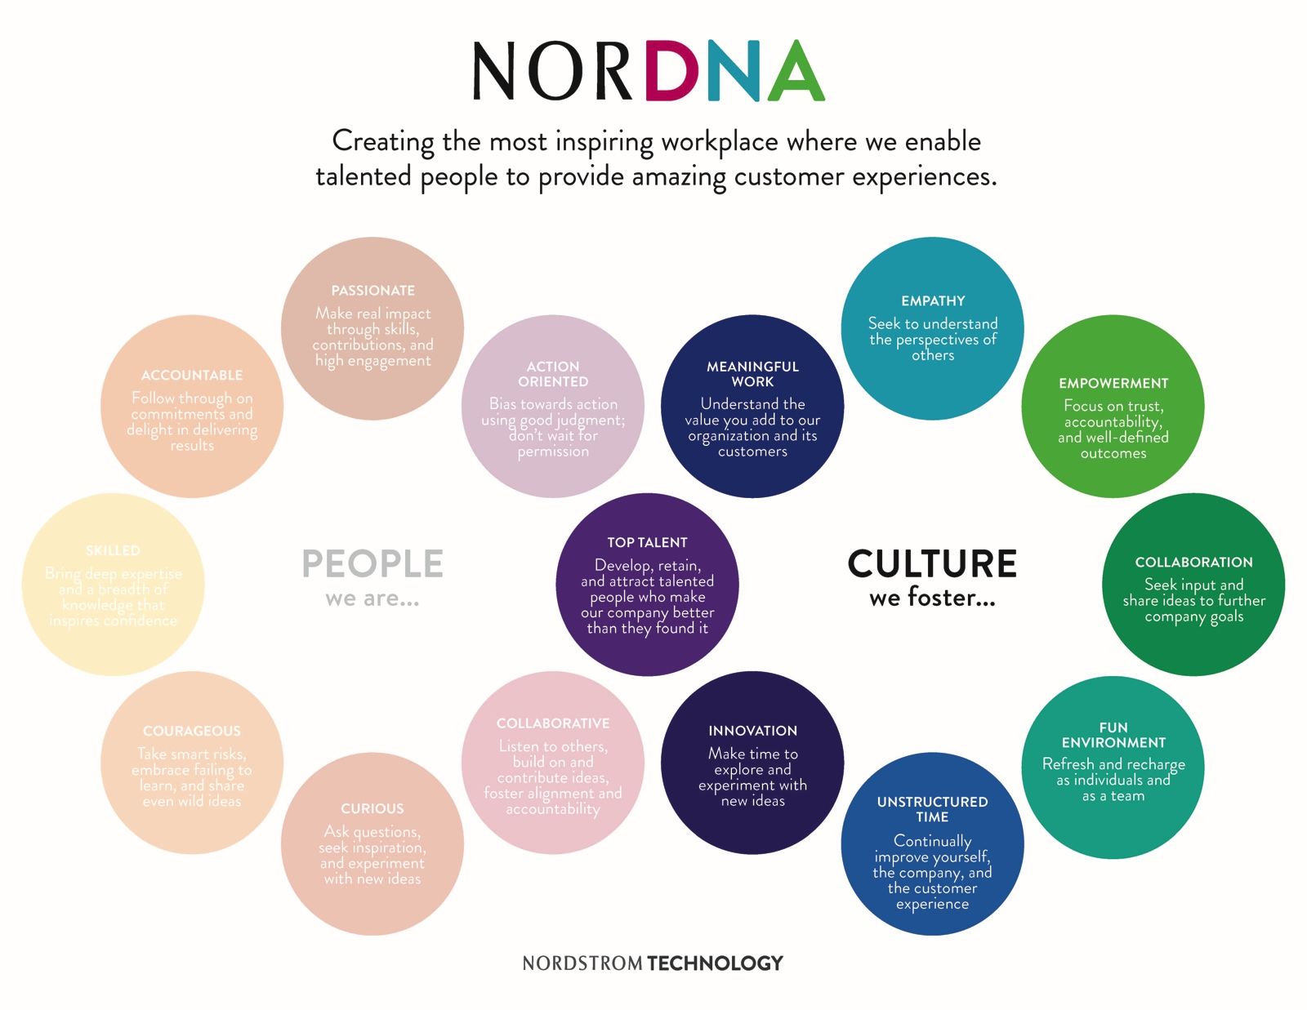
Notes:
The right side of the framework defines our shared set of values that we believe are the key to delivering great service to our customers. We focus more on this side because our culture is what attracts, retains, and enables talented people to do great things. This brings us to our second take-home:

Slide 12
Honor your existing culture with your “new” culture.
Take-home 2:
Notes:
Honor your existing culture with your new culture—acknowledge your past, then use it as solid footing. Because we’ve had “Use good judgment” and excellent customer service as the core values of our strategy for over a century, we made sure to keep them core to NorDNA. If we would have tried to create a culture by dictating new things that weren’t core to Nordstrom, our employees would have seen it as a mandate and it probably wouldn’t have been as easily adopted.
Instead of simply explaining our culture and showing examples of how we’ve gotten that buy-in, we believe that showing is better than telling. Thus, I will be using examples of some interesting things at Nordstrom Technology that are currently happening to highlight a few four cultural values in our NorDNA.

Slide 13
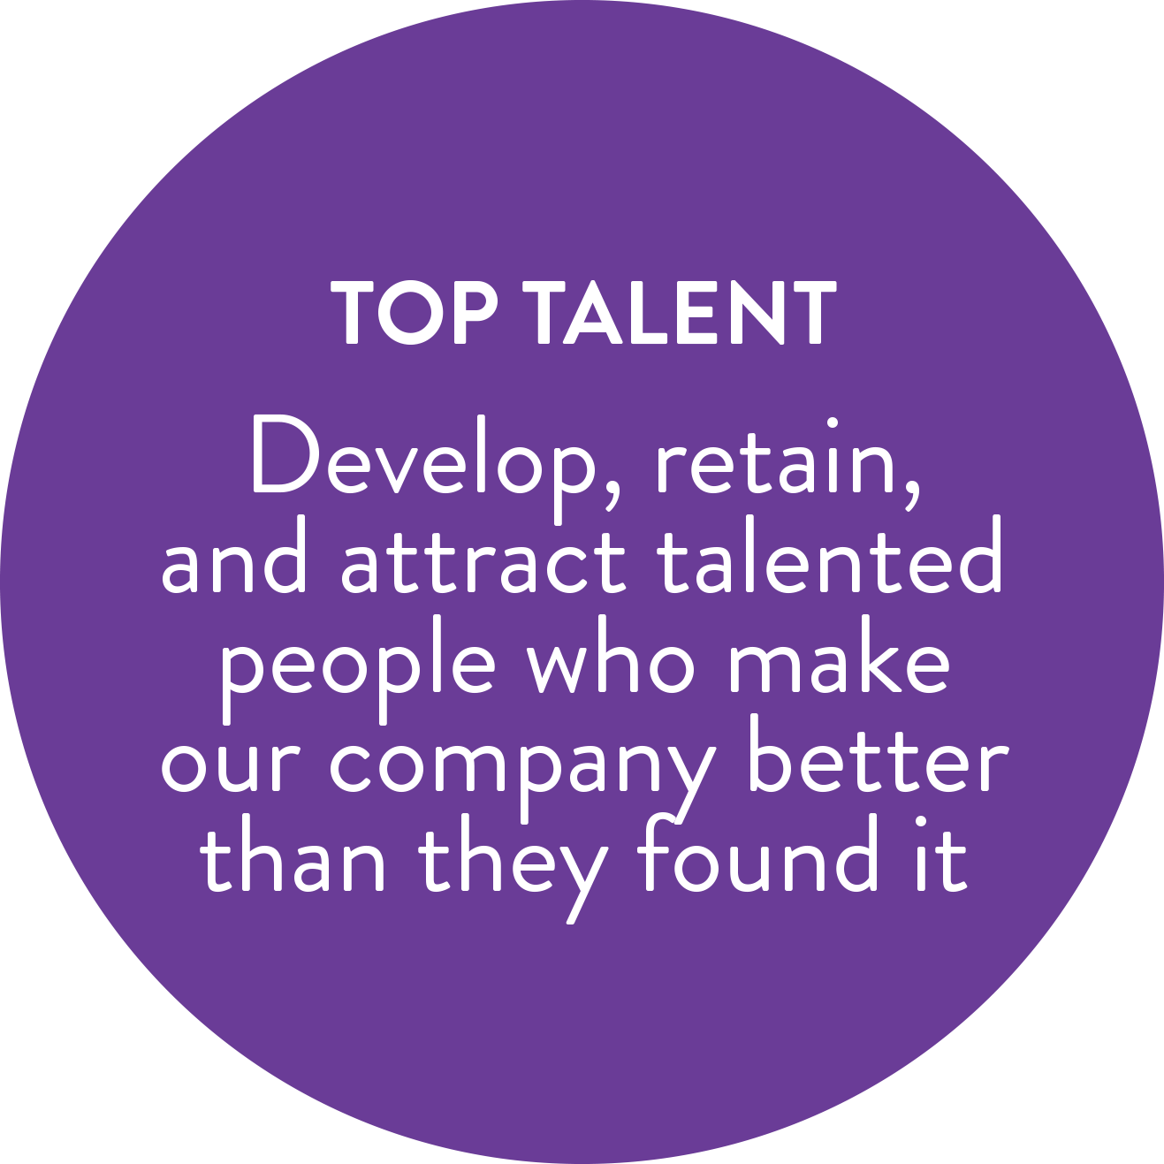
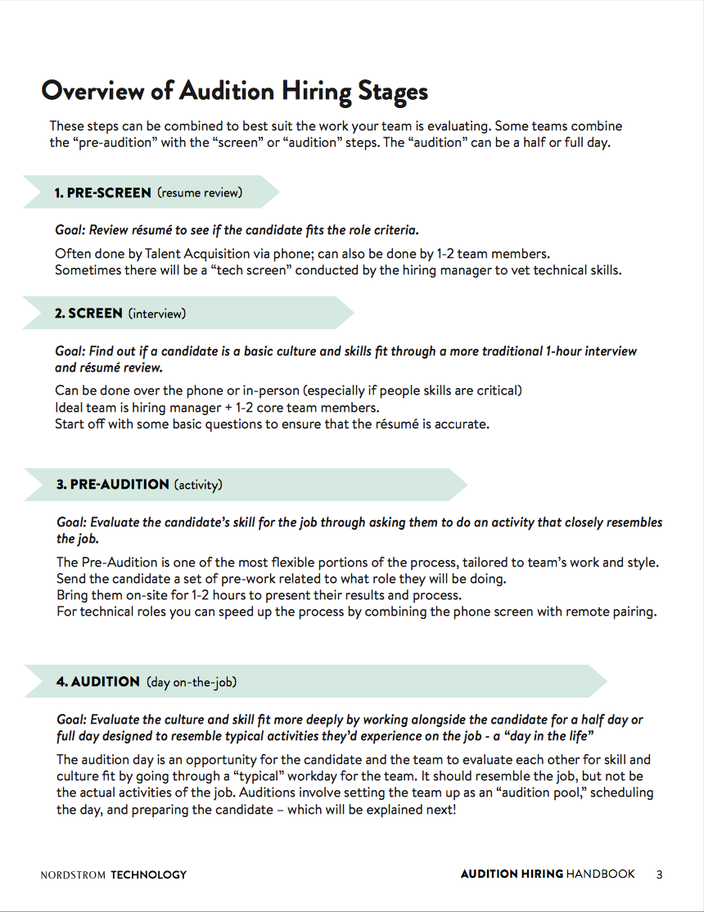
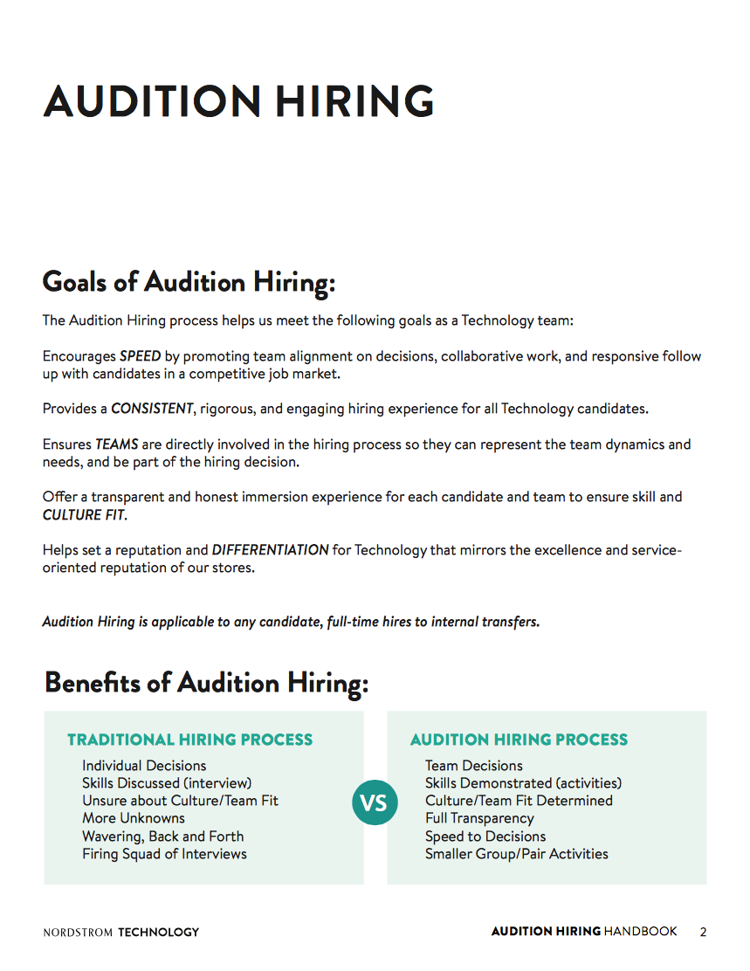
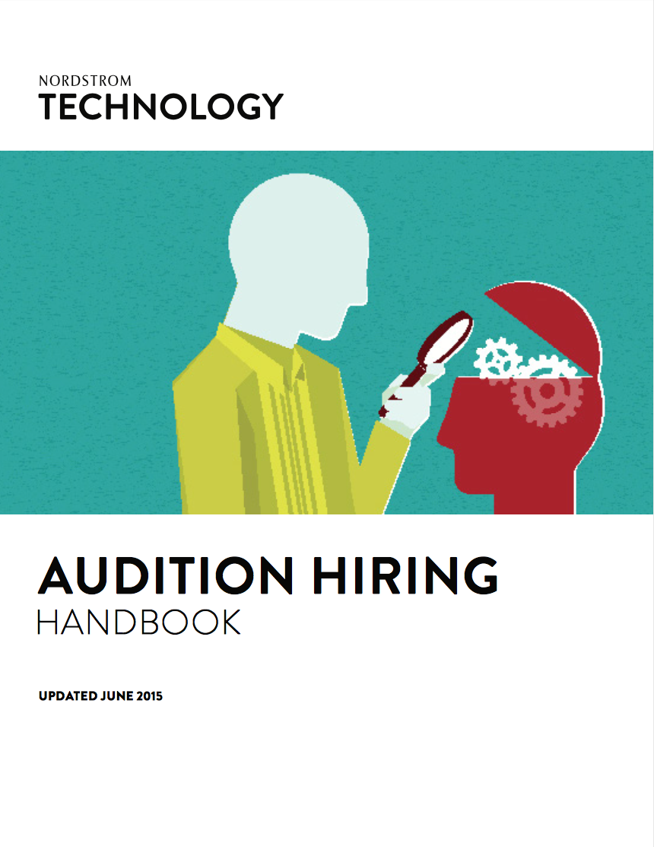
Notes:
The first step to having a NorDNA culture starts with developing, retaining, and attracting Top Talent. This is also why we focus on the right side of the NorDNA framework: if we hire the right people, culture training becomes a lot less necessary. We encourage all teams to use audition hiring to ensure we’re hiring the most talented people who also are a good cultural fit—it’s about finding a good fit for both the employee and our teams.
Audition hiring is a tiered hiring process that helps us attract great talent. Candidates are either Nordstrom customers or future customers, so we attempt to make all candidates feel valued regardless of if they are selected for the position.

Slide 14
STEP 1: PRE-SCREEN (résumé review)
STEP 2: SCREEN (interview)
STEP 3: PRE-AUDITION (activity)
STEP 4: AUDITION (day-on-the-job)
Notes:
The first step of audition hiring is similar to the traditional hiring process: the resumes are screened to see if the candidate fits the role criteria as posted. This is often done by Talent Acquisition, or by the hiring manager. For some of our more technical roles, this is where there would be a tech screen conducted by the hiring manager to vet technical skills.
After a candidate’s resume is screened for general role criteria, the candidate is offered a phone or coffee screen to find out if they are a basic culture and skills fit. This is probably the most traditional part of our hiring process. Typically, this would involve a video call or in-person conversation with 1 or 2 core team members.
If all team members involved in the coffee screen ‘thumbs up’ the candidate, the next round is the pre-audition stage. This involves evaluating the candidate by having them present work that closely resembles what they’d be doing on a daily basis. Typically, this is the most flexible part of our hiring process, tailored to each specific team’s work and style, and culminates with a presentation by the candidate or remote pairing to show code. For many of our more technical roles, the screen and pre-audition stages are combined by using remote pairing.
The last part of the process is a day-on-the-job audition to evaluate the culture and skill fit of the candidate for a half or full day. The audition day is an opportunity for both the candidate and the team to evaluate each other for skill and culture fit. This day resembles the job, but also includes business partners and frequent collaborators of the team to ensure that it’s not just a cultural fit for the immediate team, but also Nordstrom as a whole.

Slide 15
TRADITIONAL HIRING PROCESS
AUDITION HIRING PROCESS
Individual Decisions
Skills Discussed (interview)
Unsure about Culture/Team Fit
More Unknowns
Wavering Back and Forth
Firing Squad of Interviews
Team Decisions
Skills Demonstrated (activities)
Culture/Team Fit Determined
Full Transparency
Speed to Decisions
Smaller Group/Pair Activities
vs
Notes:
With the traditional hiring process, the hiring manager usually makes the decision individually after conversations with the candidate, and typically involves a short amount of interaction. We encourage the use of audition hiring over traditional processes for many reasons. First, all parts of the process utilize team members and close business partners that all have to “thumbs up” the candidate to move onto the next step. This makes the hiring process a team-based decision. Similarly, the candidate gets to demonstrate his or her skills both in a private environment (during the pre-audition) and in the work environment (during the audition). Cultural and team fit can be determined after a full day of interaction, and conversely, the candidate sees full transparency into the team he or she is potentially joining.

Slide 16
“When we use auditions, the team feels accountable for the success of the new person; like, ‘You’re part of our family now.’”
Notes:
Not all teams use audition hiring in the same way, and that’s okay—we appreciate that they’re all trying to ensure that they can hire people that work well for their team and Nordstrom. A director of one of our teams said, “

Slide 17
Highlight and amplify your culture within all aspects of the employee lifecycle.
Take-home 3:
Notes:
-Already hiring people, we now use NorDNA language in job descriptions and during all stages of the audition hiring process to the candidates. Their first exposure to NorDNA is during the interview process! Technology job descriptions include NorDNA language, the candidate sees NorDNA during the audition process, then will receive training during the onboarding process where we give an introduction to how NorDNA was created and how employees can embody the idea of using good judgment. We also encourage teams on a daily basis to use NorDNA, further reinforcing that shared language.

Slide 18
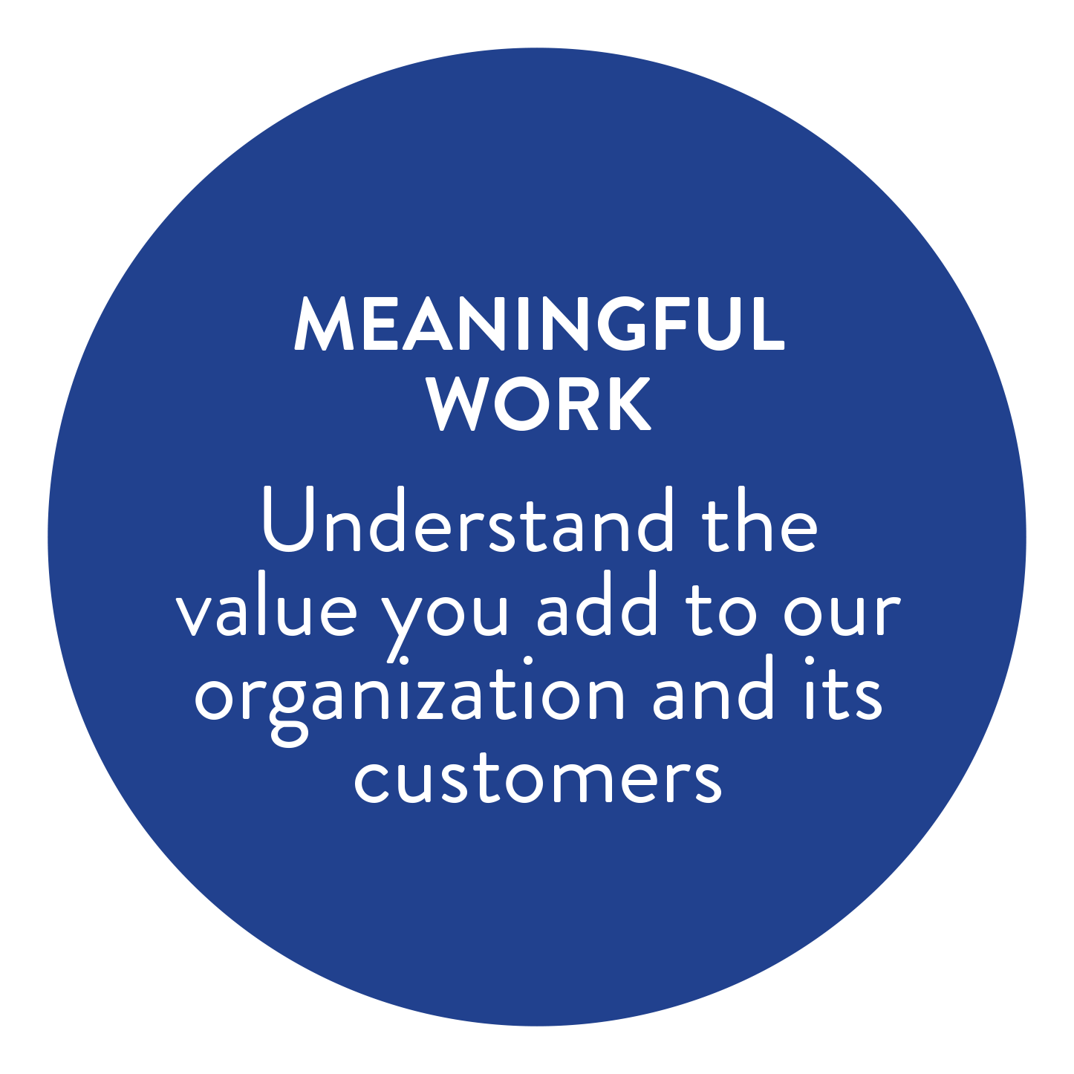
Most Impactful NorDNA Value
Percent of Org
Notes:
Meaningful Work is our number one most impactful NorDNA value to the employee experience: employees want to know that the work they’re doing adds value to Nordstrom. We typically describe meaningful work by explaining that each employee should be able to tie the work they’re doing straight to the customer.
I mentioned that this is our top NorDNA value that is important to our employees, but it’s difficult to translate what it means, let alone measure if it’s happening. One of the ways we’re trying to do this is by a twice-yearly employee engagement survey called our NorDNA survey.

Slide 19
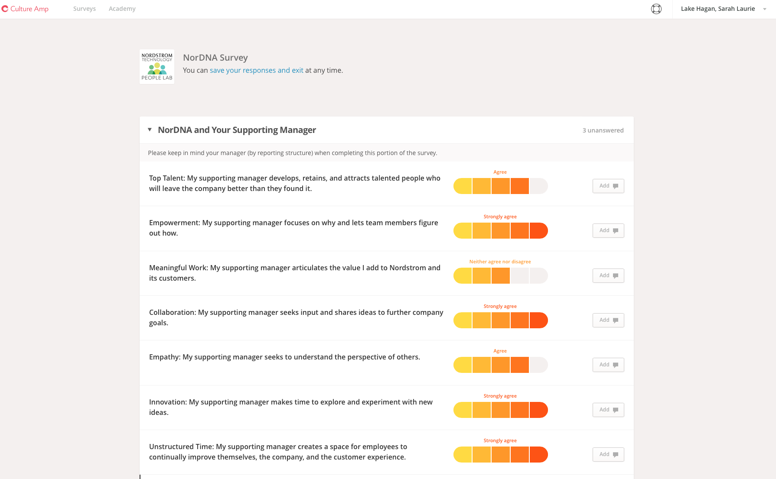
Notes:
The NorDNA survey is half manager feedback and half employee engagement survey. The first half of the survey allows individuals to rate their supporting manager on the 8 NorDNA cultural values, the last half allows us to ask more individually-focused questions to gather knowledge regarding the employee experience.
The NorDNA survey is unique, however, in that the purpose of the manager feedback section is threefold:
First, the questions have the definition of each value within the wording, so we’re reiterating the values and appropriate language to educate or re-educate employees.
Second, allowing employees to rate their manager encourages managers to remain accountable for the cultural values that we as a division have stated are important to us.
Third, employee feedback is valuable to managers in Nordstrom Technology, and this creates yet another data point with regards to personal improvement.
We’re actively trying to grow a more accountable and feedback-ready culture.
Note that unlike similar engagement surveys with other companies, the NorDNA survey’s results do not contribute to any one individual’s performance metrics or formal evaluations. Although we encourage each individual manager to use their feedback, there are no consequences or reinforcements for those individuals who are on either end of the spectrum. Instead, each supporting manager is encouraged to sit down with their teams to come up with ways to utilize the survey feedback in positive ways, reiterating to their teams that they also buy into the culture.

Slide 20
Take-home 4:
Measure your culture and your cultural progress.
Notes:
Measurement can help show cultural progress over time, as well as indicate to your teams that your culture is important!

Slide 21
Take those take-homes home!
Notes:
If you leave with anything today, it should be those four take-home tips. Get everyone involved. Honor your existing culture with your new culture. Highlight and amplify your culture within all aspects of the employee lifecycle. Measure your culture and its progress! If you don’t get these right, nothing else matters. I have four more take-home tips, but the first four are core to any large-scale cultural change from a company that is well-rooted. Once you have those, the rest become easier to roll out.

Slide 22
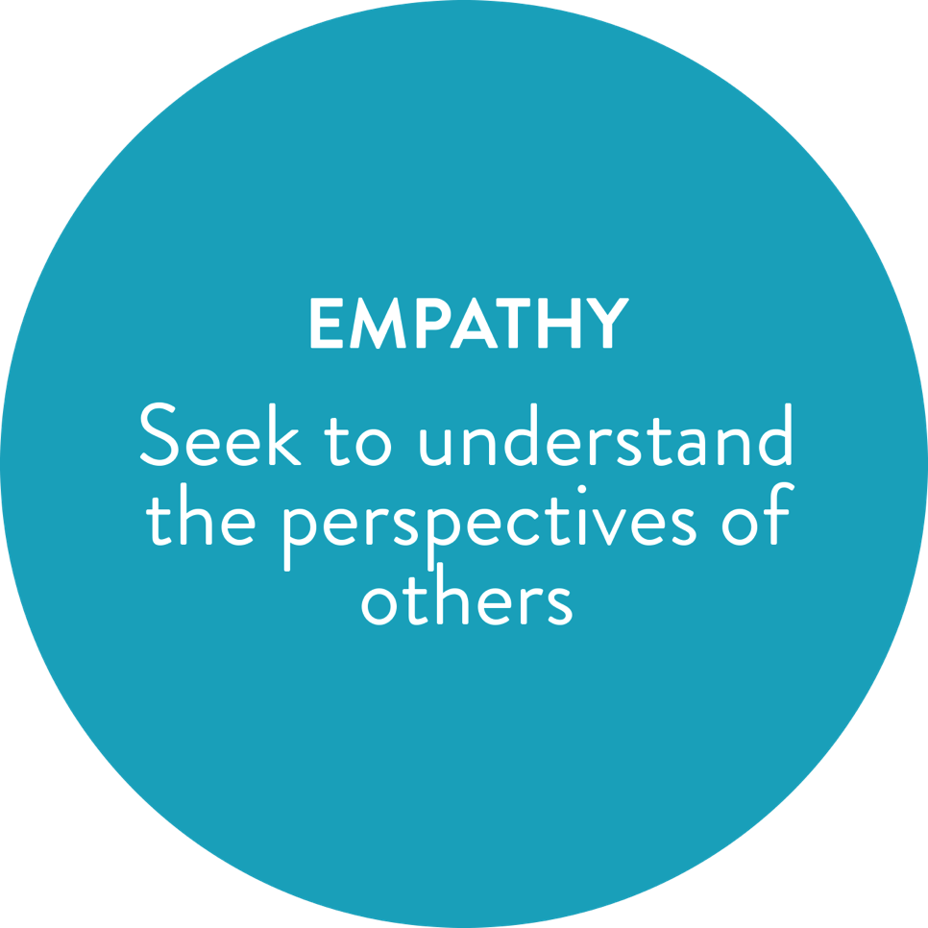
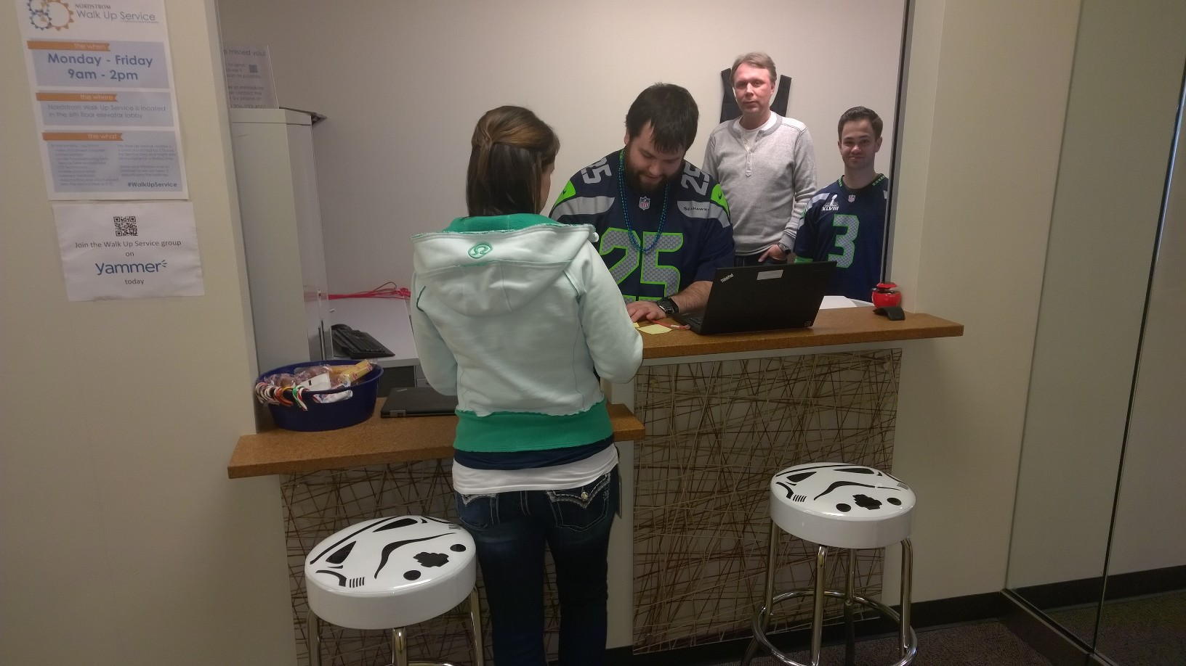
Notes:
We believe it’s critical to have an environment where we practice empathy, or seeking to understand instead of seeking to be understood. We challenge ourselves to understand others’ perspectives.
Nordstrom has a great group of 25 employees that work on our Corporate Technology Support team, who man our Help Desk for technology issues, both within the Tech division and corporate-wide. Our CTS team originally had what they thought was the highest quality service: a high-touch, we’ll-come-to-you service where if you had a problem, you could call a tech, then they would come to your workspace to fix whatever you needed.
They realized that employees would call for a tech, wait around, leave for a meeting, and then accidentally miss their window for when the technician was visiting. They realized it was control was the key design attribute employees wanted, particularly with their schedule. The CTS team originally conceptualized the Walk-Up Service Desk as a pilot in the Technology division, placed in an old hole in the wall—literally—and figured a soft launch would work well, being unsure whether the community would just pass it or actually use it as a service desk.
Sure enough, it was a hit. When the Walk-Up desk first opened, they anticipated they would see a shift in support calls into the walk-up service. Within the first week, the incident volume nearly doubled! We found out people stopped suffering small issues in silence, and could fix those problems with ease.

Slide 23
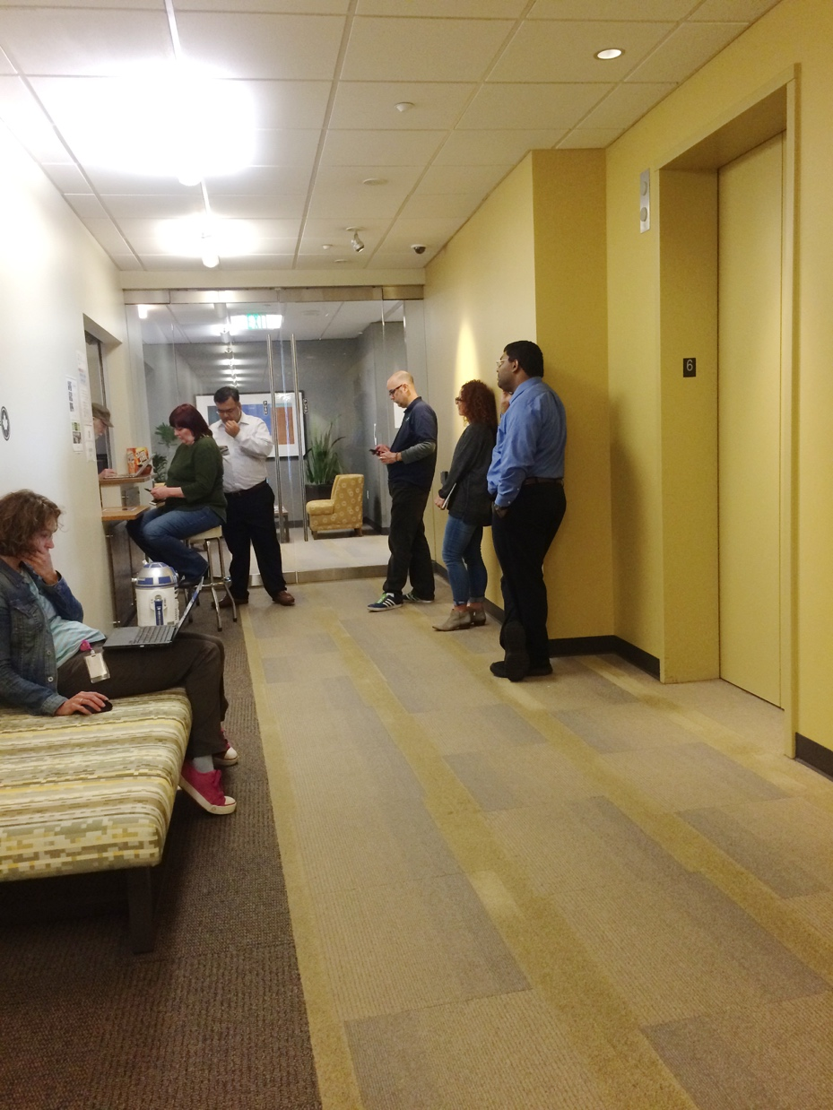
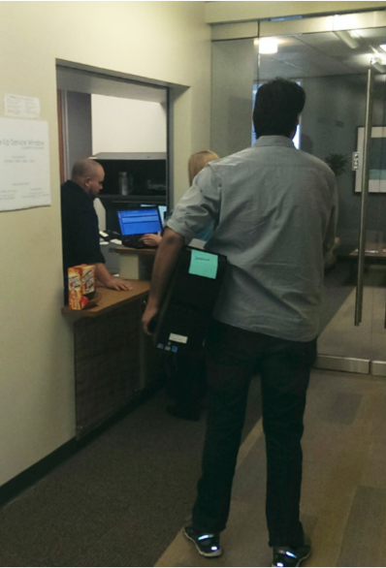
Notes:
Ultimately, the Walk-up Service was intended to serve Nordstrom Tech employees on their terms. This photo [desktop dude] makes me laugh, as it’s an employee who realized that it was better for him if he lugged up his desktop machine to the Walk-Up Service Desk instead of wait for scheduling. In this photo that I took last month, you can see that the need for the Walk-Up desk was proven quickly—it’s now a staple within Nordstrom Technology, and the team is working on how to bring that service to other areas of our business.

Slide 24
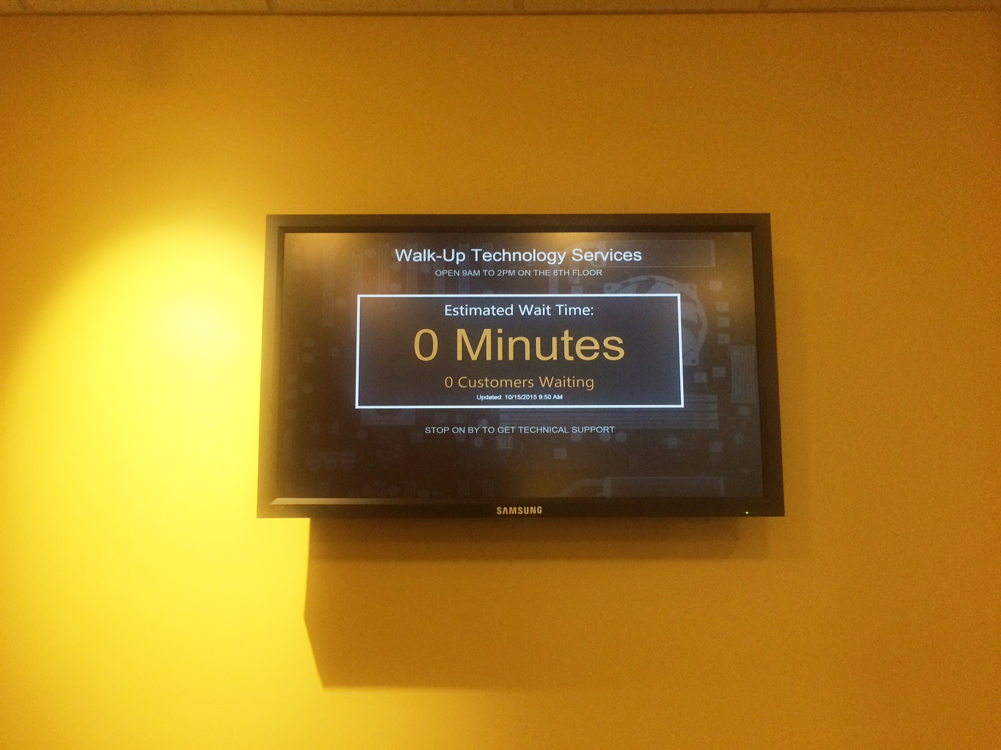
Notes:
To continue their story, the Walk-Up Service Desk was such a big hit among technology employees, they’ve started iterating on their idea to make it even better. You saw the line of 6 people in the last slide, which they thought still wasn’t serving their customer as quickly as they had hope. Now, they have a dashboard you can check (that is also on our internal televisions) that show your wait time (along with how many people are in front of you) to be able to better serve. Good customer service indeed!

Slide 25
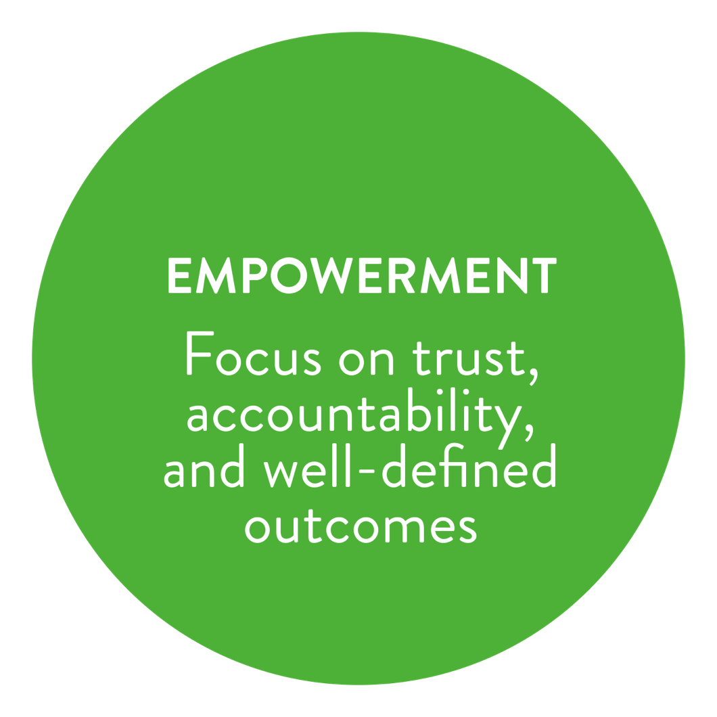
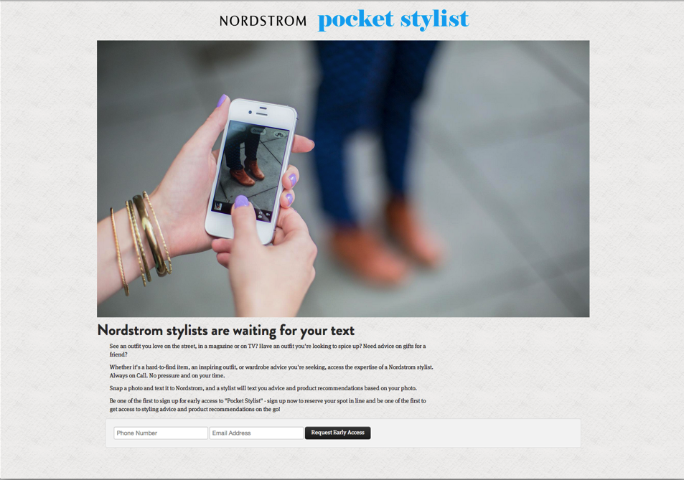
“I wish I had a stylist
in my pocket.”
Notes:
The CTS and Walk-Up Service Desk teams also show one of our most impactful NorDNA values, Empowerment. Because it’s been a staple for Nordstrom culture, we think it’s especially important to get right. I’ve talked a little about how using NorDNA language in our hiring practices has helped spread the word, and how the survey has helped reinforce the new cultural language.
We speak of empowerment by telling managers to define the end means, but not the how. In 2013, our Innovation Lab did some need finding with customers to find out how we could improve their customer experience with us. They kept hearing, “I wish I had a stylist in my pocket,” usually because they wanted help with an item or an outfit. The group decided to go to the Target next door and buy both an iPhone and a $30, 1-month data plan. They made a quick website for people to sign up to be beta users, and contacted all their friends in hopes of getting a handful of people to sign up.
Sure enough, 50 of their friends, family, and random Twitter followers signed up to be beta participants. They then let those users know that they could text the Pocket Stylist if they had any questions…

Slide 26
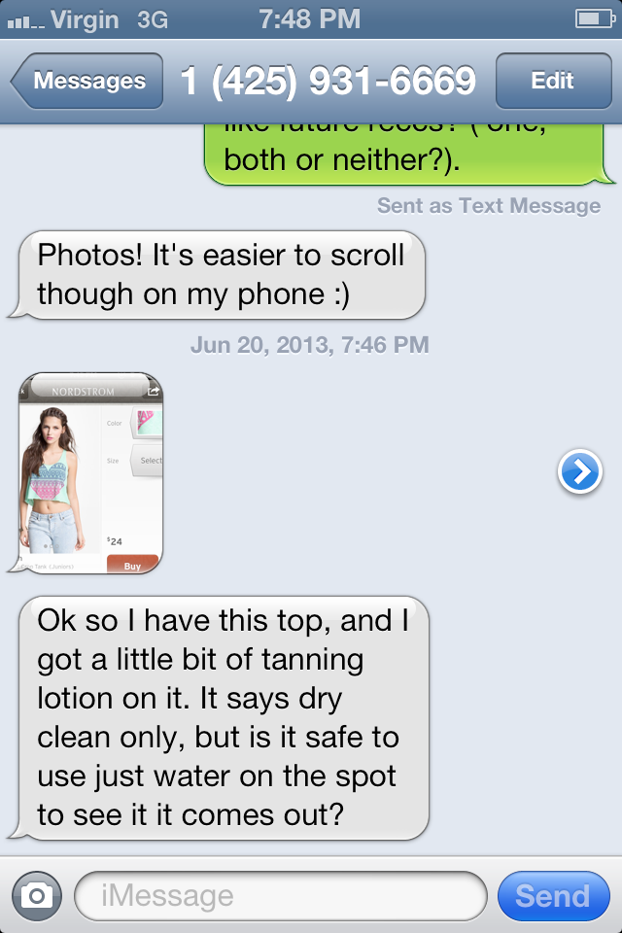
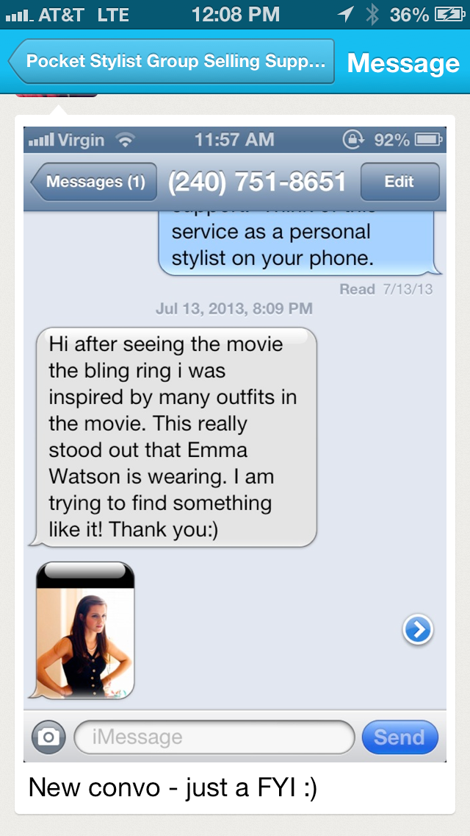
Notes:
…and very quickly realized that none of them had enough style to pretend like they were qualified.
They quickly ran over to our stores and convinced 10 Department Managers to join a Group Me so that they could be the experts when someone needed advice.

Slide 27
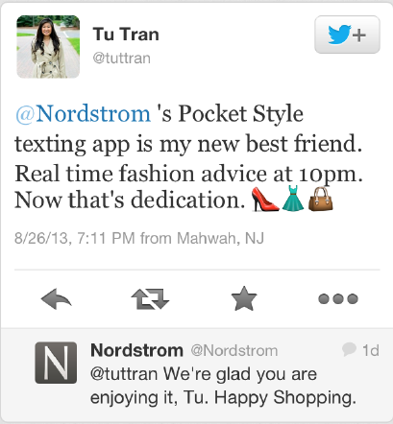
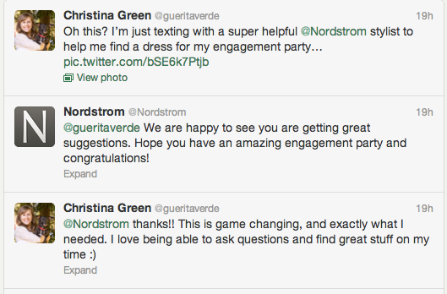
Notes:
This pilot ran for about six months, and the feedback was consistently positive.

Slide 28
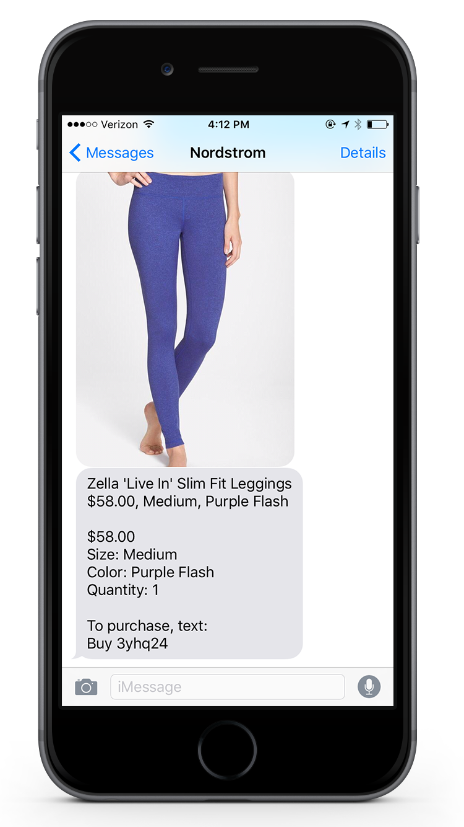
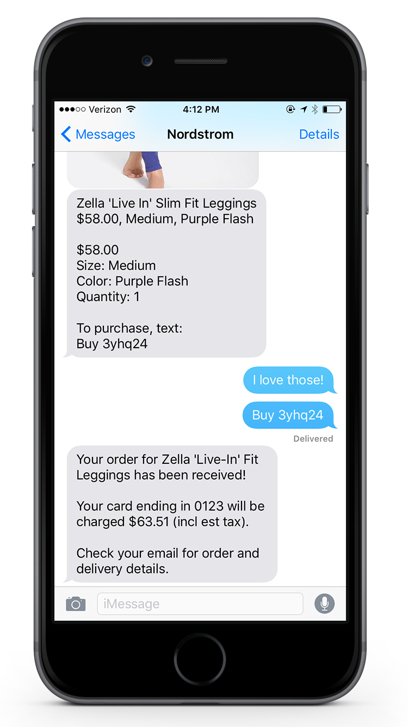
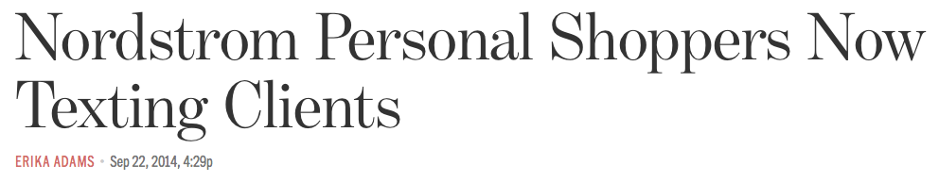
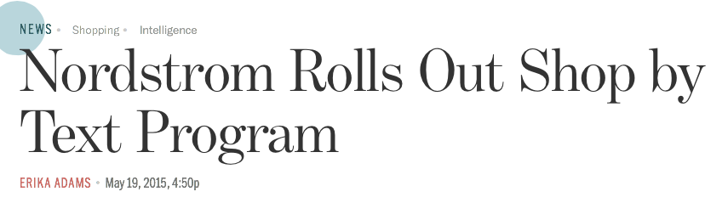
Notes:
In fact, the feedback was so good that we’ve now launched Text Style to the masses. It went from, “How can we help customers connect to stylists on their terms?” to “Would customers want to buy via text?” Sure enough, you can now do this—text back and forth with a stylist in a store, ask for advice, and even buy an item via text that will be shipped to you for free.
(Shout out to UX Designer Ashley Costanzo who mocked these up for me last minute!)
The TextStyle app is an awesome example of empowerment: the original team decided to prototype and try an idea instead of worrying about all the features up front. Our Customer Mobile Apps team, who now owns this project, continued that empowerment by adding more features based on feedback they heard from customers, and coming up with a great product.
I tell you this story because we tell this story, and the Walk-up Service Desk story, along with many others, to employees as example of the culture, both empowerment and the overall NorDNA attitude.

Slide 29
Take-home 5:
Help employees translate your culture into actions through telling stories of others.
Notes:
That leads us to Take-Home 5: Help people translate core values into actions through telling stories of how others have brought those values to life. Point out things your team is already doing that align with your cultural change! Would the CTS team have been so bold in their Walk-Up desk service without NorDNA? Probably! But using them and their journey as an example to other teams shows that the cultural change isn’t actually change, but more of a shared language tool.
The neat part is, once everybody is on board, the teaching and translation part subsides. One of our directors, when asked how he introduces people to the NorDNA culture, said…

Slide 30
“The best part of NorDNA is if your team already has it, you don’t have to teach it.”
Notes:
One of our directors, when asked how he introduces people to the NorDNA culture, said…
That’s true, we may not have to teach it, but we’re always trying to educate people so that we can continually have that shared language.

Slide 31
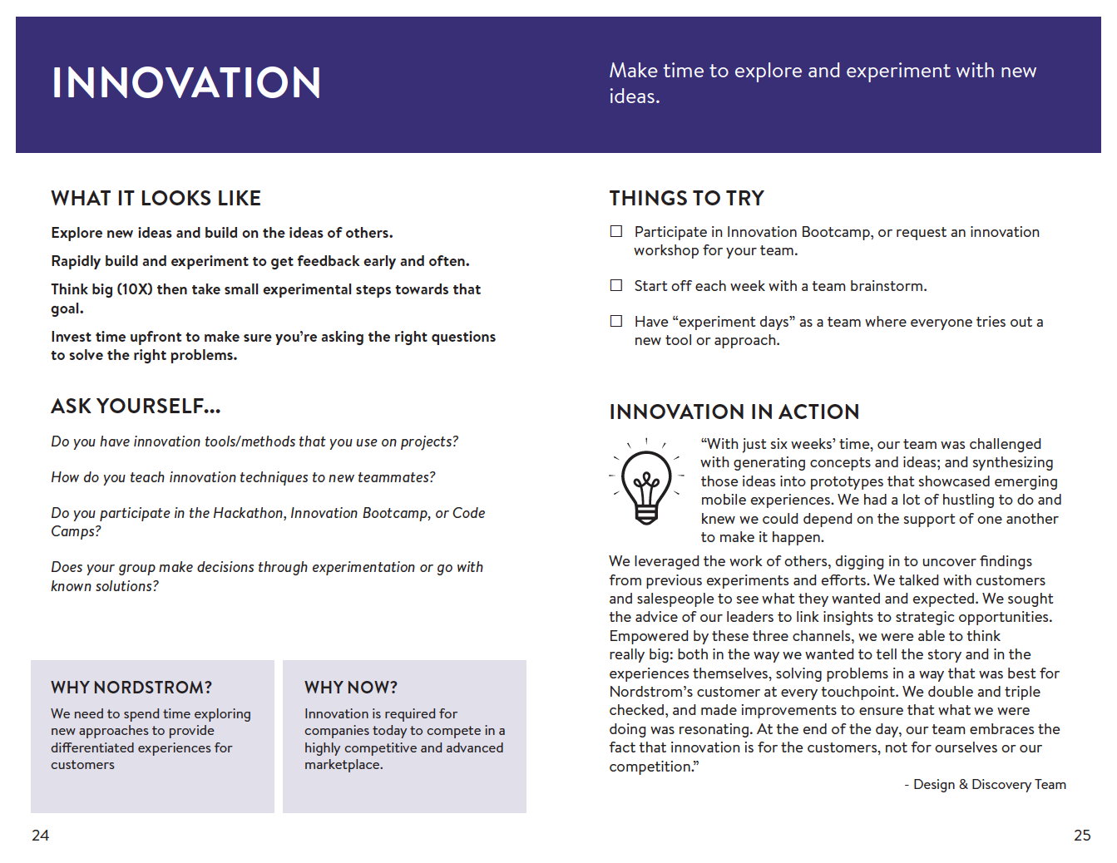
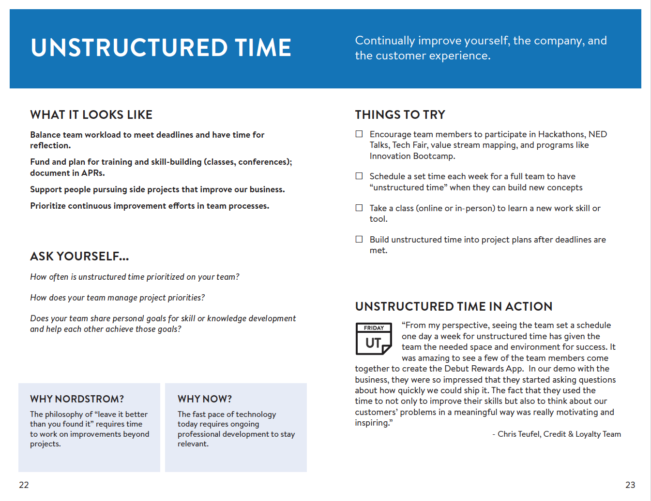
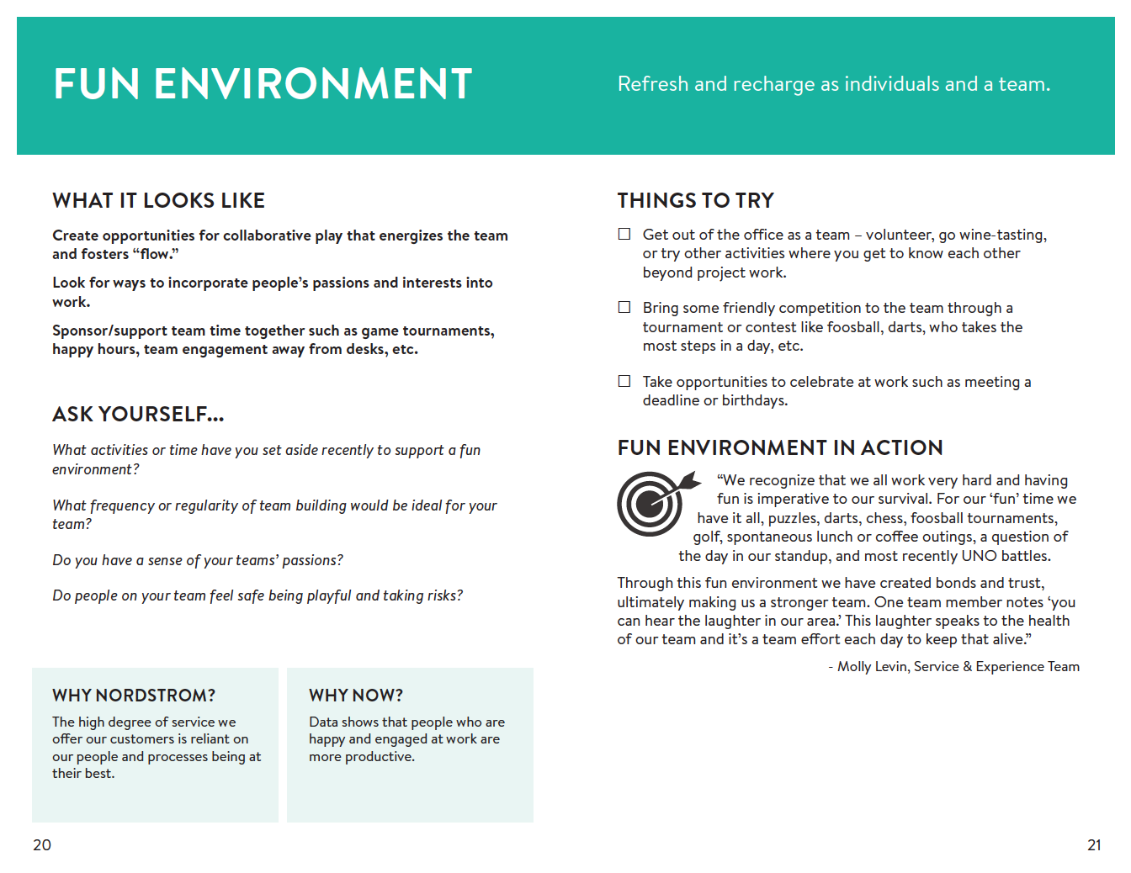
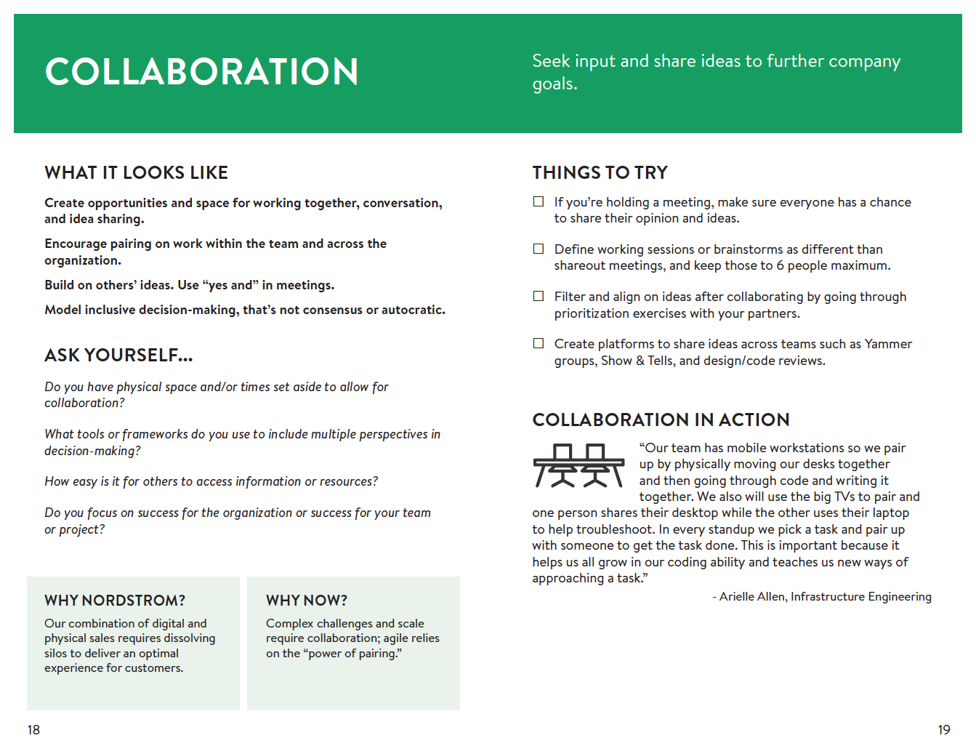
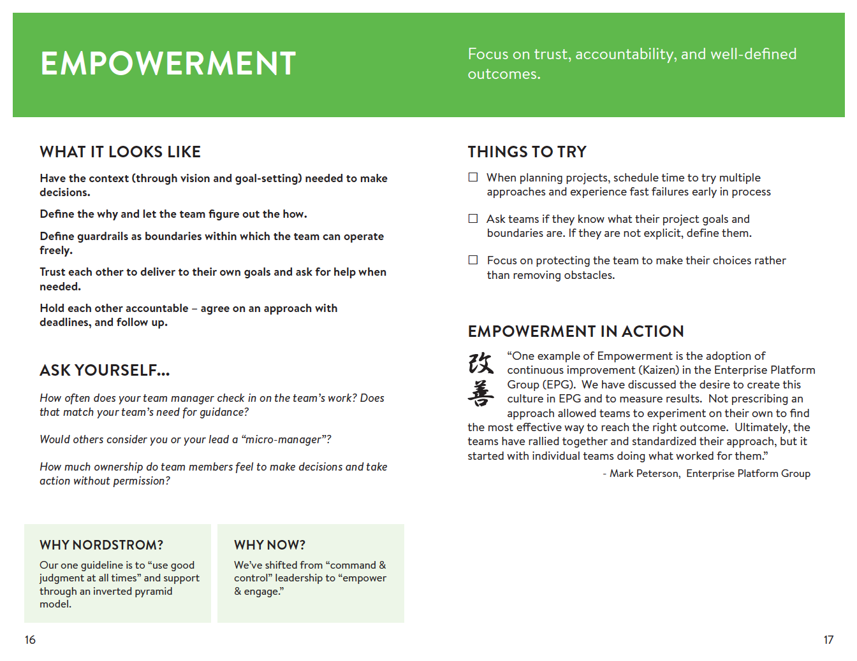
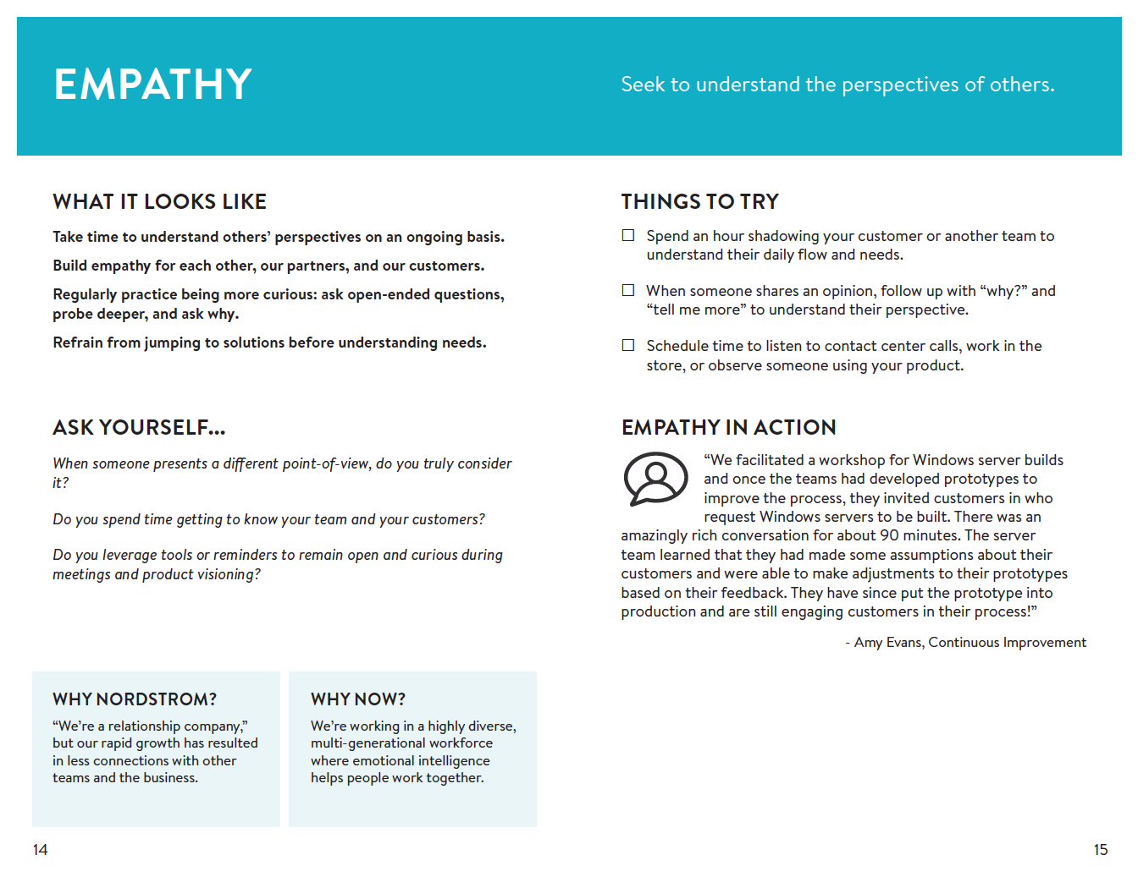
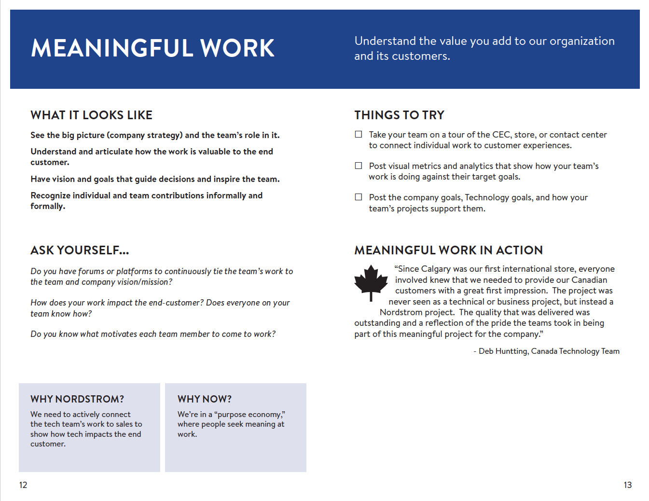
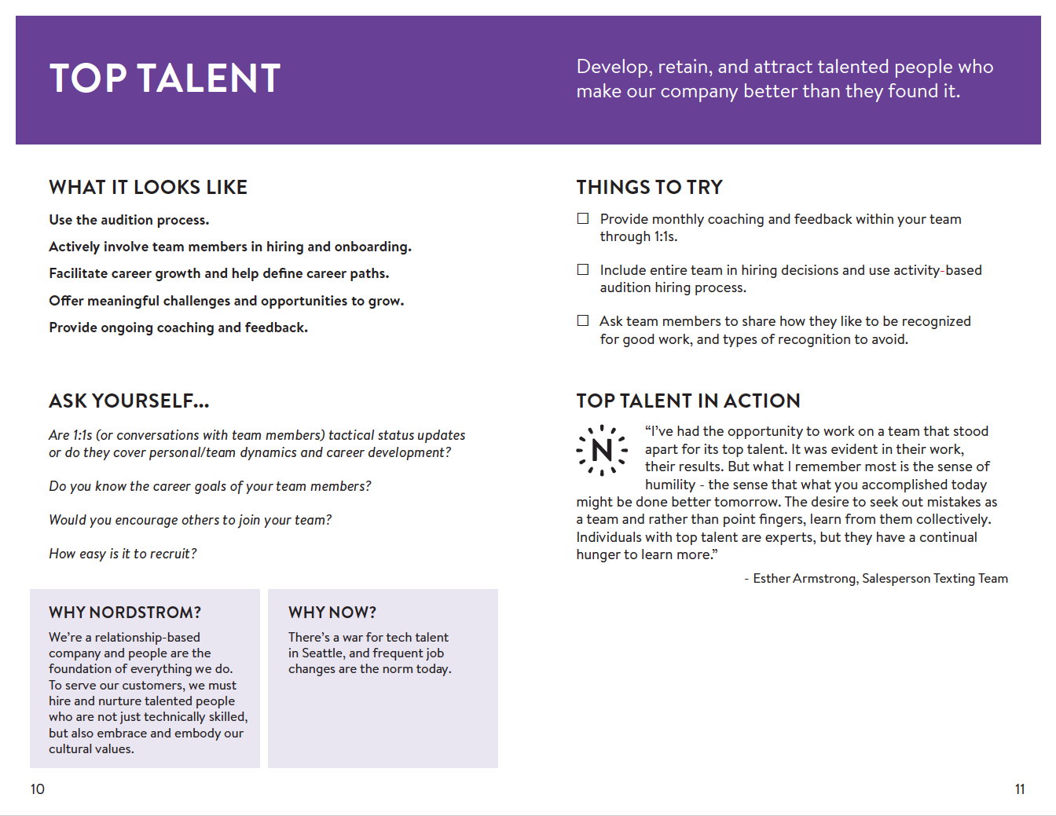
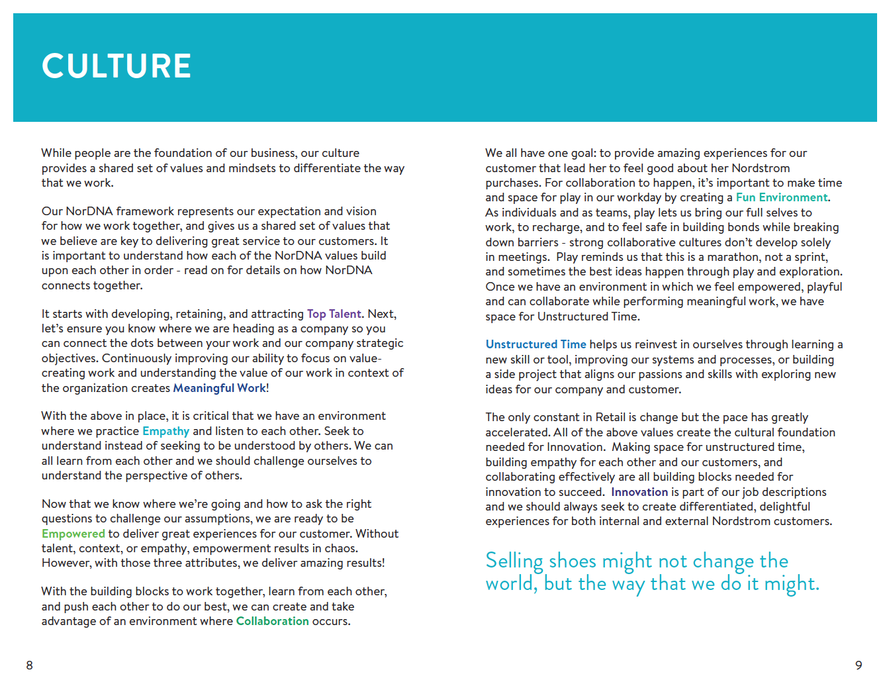
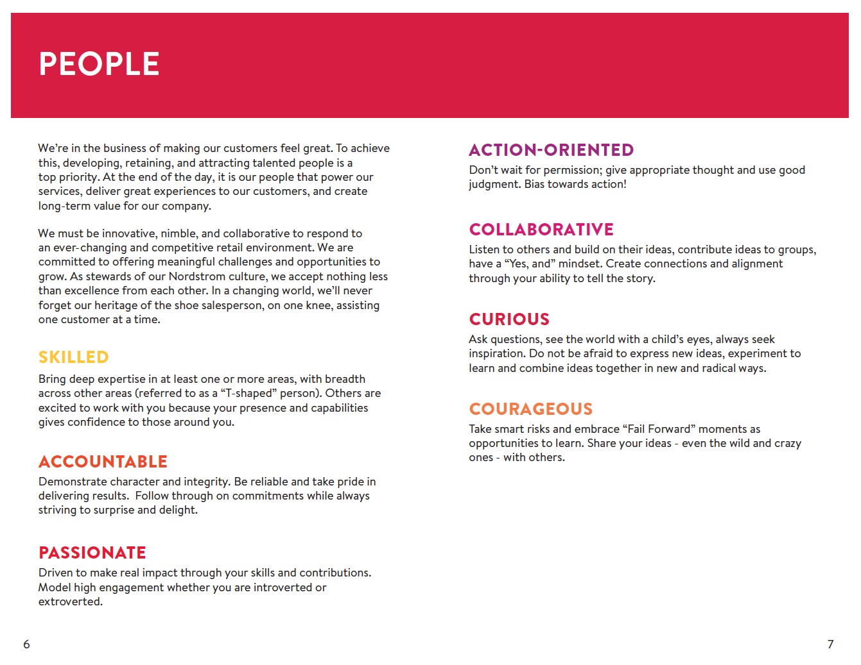
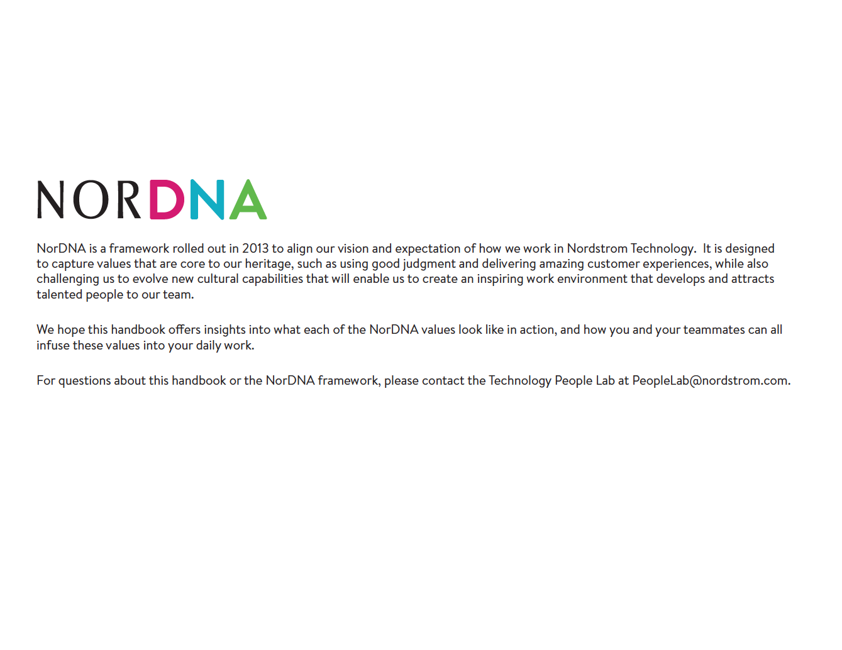
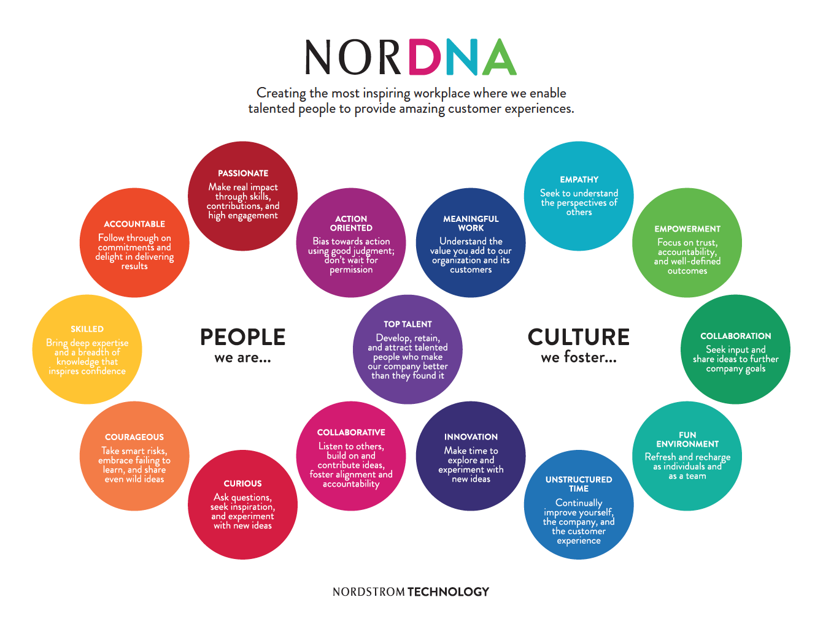
Notes:
Not everybody innately knows these cultural values, especially with new employees coming into the mix. We tried workshops about NorDNA, we have posters of the NorDNA framework up around the building, we message through the survey, but we also have something a little more hands off: handbooks!
The NorDNA handbooks are for anybody to take to understand more about our culture. They explain our cultural progression, then how each of the values tie together. Subsequent pages go through each value more in-depth, with a brief section on what each value looks like, why it’s important in Nordstrom and why it’s important now. We also talk about how they can try it within their own teams, and examples of the value in action.
A funny story: one of my colleagues was having coffee with a new hire from Microsoft, and asked him what he thought about the NorDNA handbook. He said it was helpful, but he wanted even more examples of how it translated into behaviors—he was looking for the “reference implementation.”
This transitions into our next take-home:…

Slide 32
Take-home 6:
Not all cultural “teachings” must be formal.
Notes:
Not all cultural “teachings” must be formal, like a handbook, or a reference implementation. Some people like stories, others need to come around on their own time. Help people translate core values into actions through telling stories of how others have brought values to life. When you get buy-in from a few people, they’ll start acting in accordance to your culture, and the whole thing snowballs. Similarly, creating documents such as our handbook can help educate people on their own time, when they’re ready to be in the process.
To wrap up, I showed 7 take-home tips for your own company:

Slide 33
1
Get everyone involved.
2
Honor your existing culture with your “new” culture.
3
Highlight and amplify your culture within all aspects of the employee lifecycle.
4
Measure your culture and your cultural progress.
5
Help employees translate your culture into actions through telling stories of others.
6
Not all cultural teachings must be formal.
Notes:
…but there’s one more.

Slide 34
Final take-home:
It’s an ongoing process!
Notes:
We’re still measuring our culture, still educating people about what NorDNA looks like, and still using our best judgment to refine our values.

Slide 35



@NordstromPLab
PeopleLab@Nordstrom.com
www.nordstromtechnologypeoplelab.com

